Slide 1
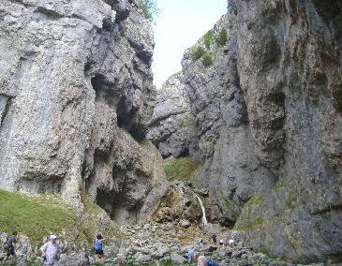
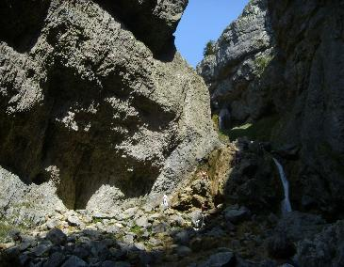
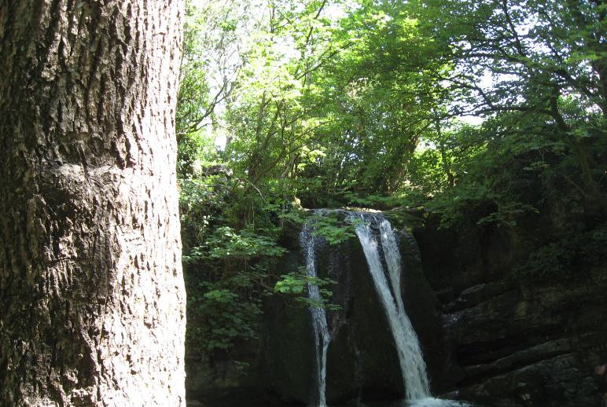
Gordale Scar and Janet's Foss
Gordale scar is a deep gorge cut into the limestone landscape with 100 metres high overhanging cliffs with Gordale beck flowing through the gorge. Has tufa deposits and scree slopes. Formed in the ice age by meltwater carving a cavern which then collapsed creating the gorge and waterfall.
Janet's Foss is a waterfall on Gordale beck- a tributary of the River Aire

Slide 2
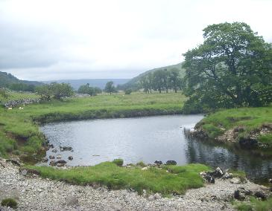
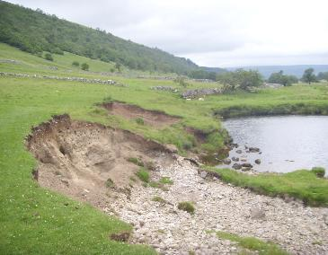
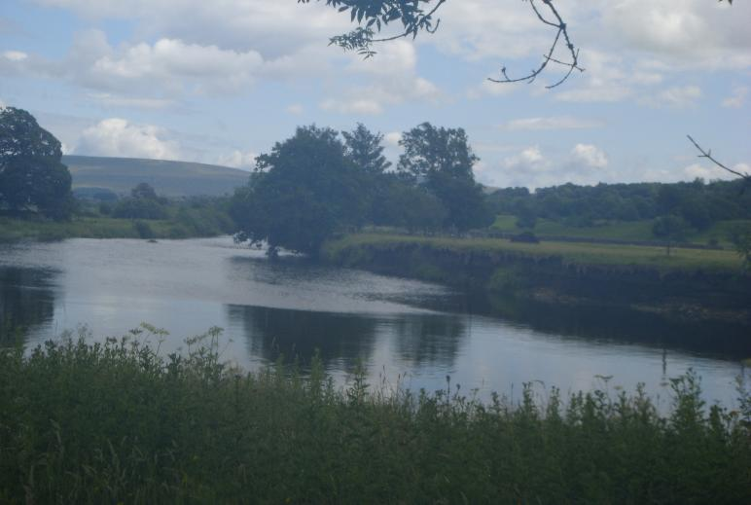
River Meanders and features related to them
Bends or curves in the river channel in the middle or lower course formed by processes of deposition and erosion.
The fastest current- the thalweg- erodes the outer bank forming a river cliff which can be seen in photo 2 while the slower current on the inside deposits sediment forming a slip-off slope.

Slide 3
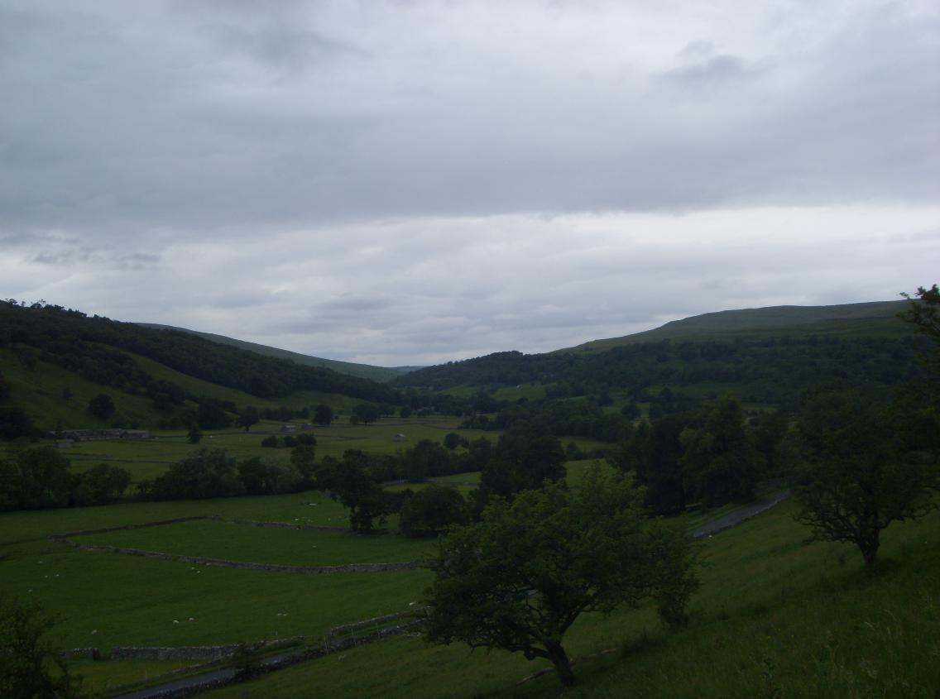
U-shaped valley
Formed in the Devensian ice age, as glaciers moved through valleys, scouring the landscape and under the immense weight and power it eroded the existing V-shaped valley floor forming a steep sided flat-bottom U-shaped valley

