Slide 1
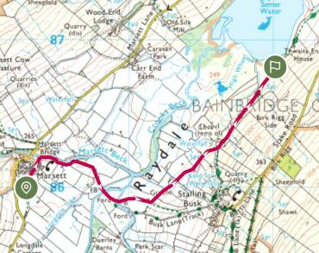
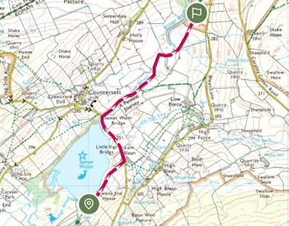
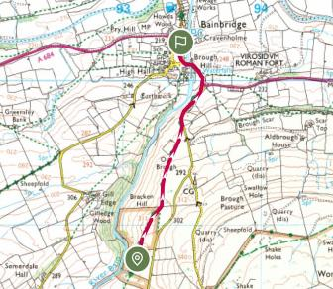
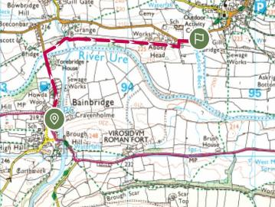
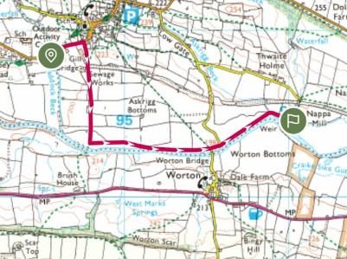
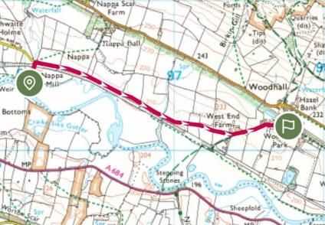
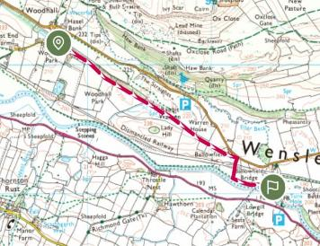
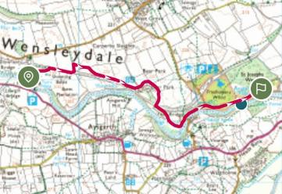
Route planning- Day 3

Slide 2
Our rucksacks- sharing weight
All of our rucksacks were packed with both our own kit but also leaving room for the teams kit. We also ensured that no one person’s bag was too heavy for them to carry and if their bag felt too heavy, the heaviest pieces would be shared among the group to lighten the weight of the bag and allowing our group to continue.

Slide 3
Safety Precautions
When mapping our route, we mapped escape plans for each section of the route ensuring we always had somewhere to go. Between each section there was an alternative route which we had familiarised ourselves with.
We had a tracker and an emergency phone with use which we all knew how to use and regularly logged our location
We carried an emergency shelter and first kit in case of emergencies
We ensured every person in the group knew how to use all the equipment
We ensured our bags did not exceed 25% of our body weights

Slide 4
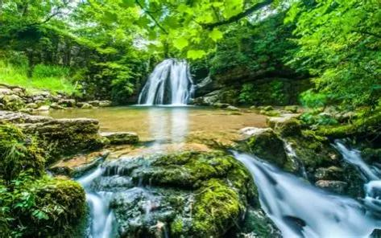
Our expedition

Slide 5
Daily routine- Day 1
On this day we set off from the Malham tourist information centre at 9.00am
We were the 3rd group to set off
We had lunch at Janet’s Foss and admired the waterfall.
It took us longer than we thought to get to checkpoint one, but we took a detour to see some waterfalls, which help with our aim.
We took breaks when anyone wanted/ needed them.
We had a lift from checkpoint one to two as it’d almost been our seven hours.
From checkpoint two is took us around two hours to get to the campsite
Which meant that we arrived around 7pm
In total we walked aound 22 km
Notes:
Grace

Slide 6
Challenges and solutions- Day 1
One challenge faced was the intense heat that start at around Midday and continued into the afternoon, this greatly affected our team so we had to facilitate more breaks and rests than originally planned.
Due to the intense heat and walking longer than expected, we had to make sure to not drink all of our water at once so that it wouldn't run out.

Slide 7
Daily routine- Day 2
We set off from Kettleway camping at about 9.30am
Today was a lot easier of a walk as we was mainly is a valley for the first part, so the relief was not as great so was less difficult.
We had lunch at checkpoint one, Buckden carpark
We had many breaks, again, this day but overall, generally stuck to our planned breaks as the weather was cooler, so we did were not as fatigued
We arrived at Stablefell Campsite at around 6pm after walking around 25km
Notes:
Grace

Slide 8
Challenges and solutions- Day 2
When we reached the end of a field and the ladder to the next part of the footpath the cows were blocking the pathway, as they had calves, we did not want to go to near them, so we waited until they moved further away and walked through without making eye contact and keeping quiet to not scare them.

Slide 9
Daily routine- Day 3
We set off from Stablefell Campsite at 9.10 Being the 5th Group to leave
We had lunch at Bainbridge at the checkpoint.
We took a small diversion when our path was blocked. But we made our way to checkpoint two where we had a break under the shelter as it was raining.
We finished our expedition at Aysgarth falls visitor centre, where we finished our aim by photographing the waterfall.
We got here at around 5.30pm After walking around 21 Km
We had our briefing an discussed the expedition.
Notes:
Grace

Slide 10
Challenges and solutions- Day 3
One challenge faced was the heavy rain, this added more weight to our bags as the tent parts would absorb the rain water making our bags heavier, to combat this we made sure to use bag covers and making sure when we took breaks they were under shelter.

Slide 11






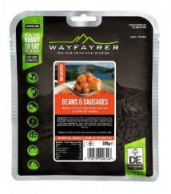


Our food
For breakfast we had porridge which was made in the Trangia and also some people in our group also had an all day breakfast from a wayfayrer packet
for lunch some of us had pitta bread and some of us had brioches but we also had snacks like breakfast bars , mint cake and others
For dinner we had food packets from wayfayrer like beans and sausages , pasta Bolognese and chilli and rice
Notes:
Lily

