Slide 1
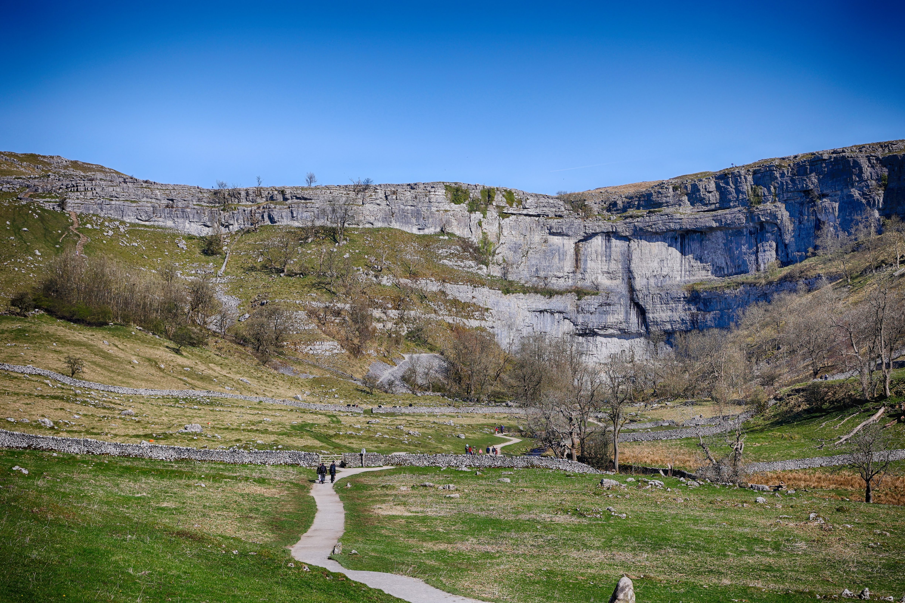
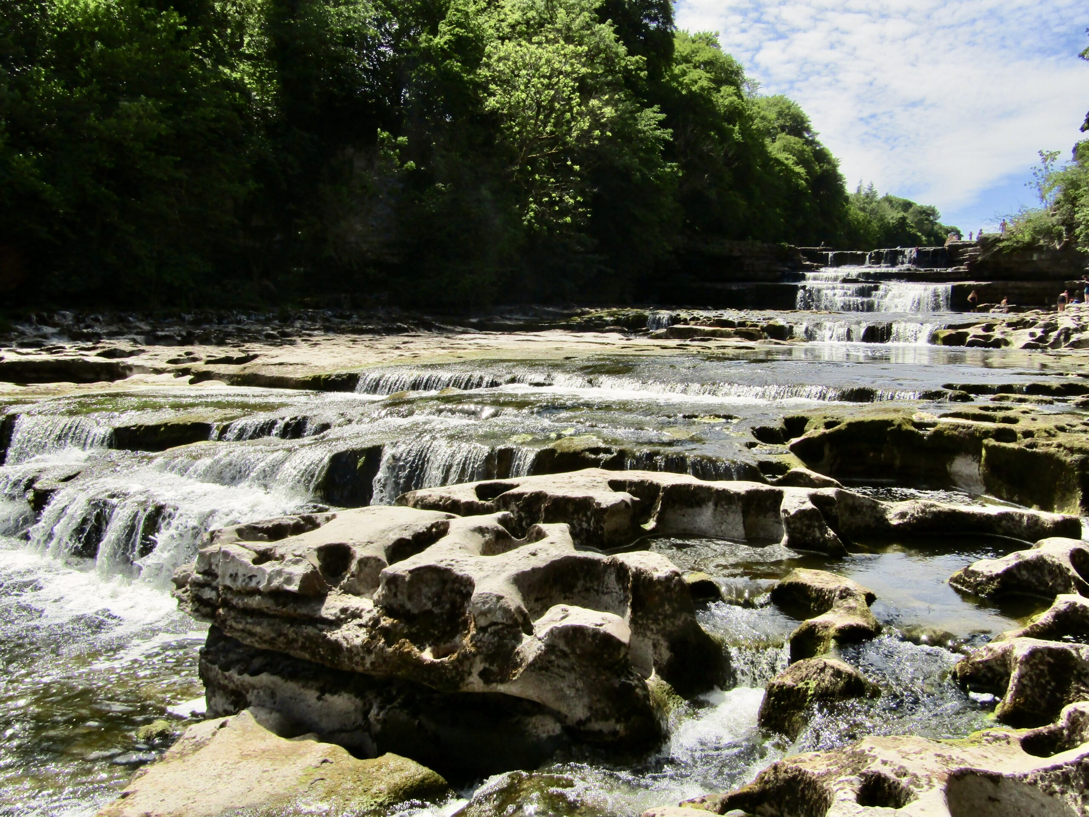
Silver DofE
OAK

Slide 2
Planning
In the weeks prior to our expedition, there was a lot of communication between the group, indicating which members were responsible for each element of the group kit.
We also had discussions about meals, planning and prepping both individual meals but also meals to be shared as a group. For example, for the first evening meal, the group cooked pasta with a sauce, and for the second evening meal, each member cooked their own meal that had been prepared separately.

Slide 3
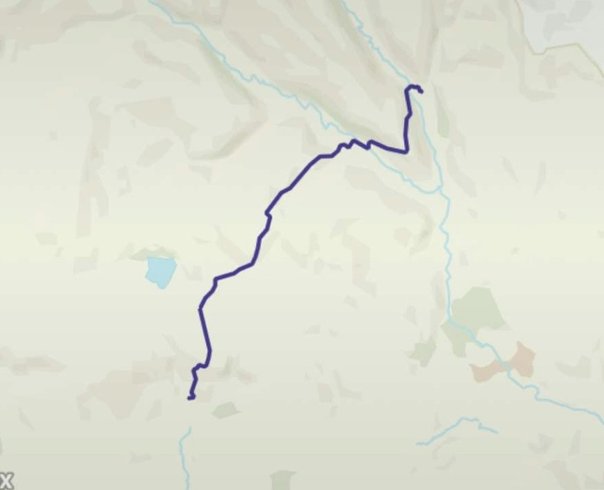
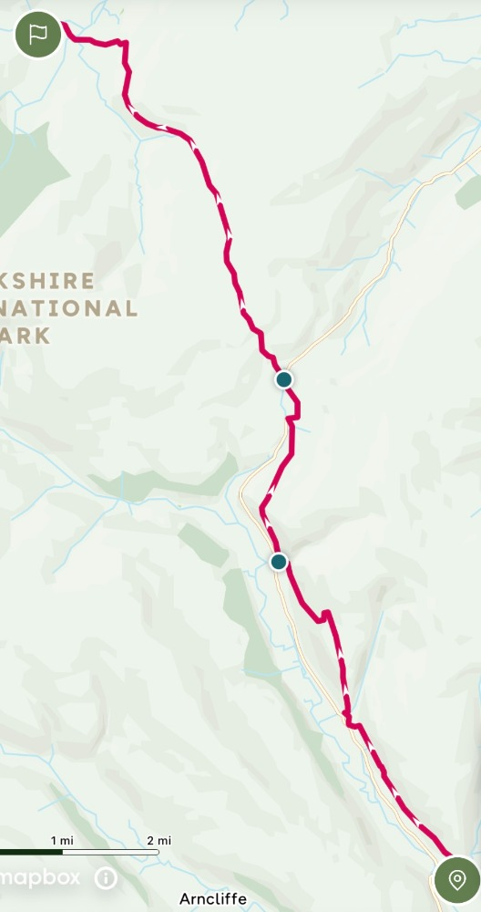
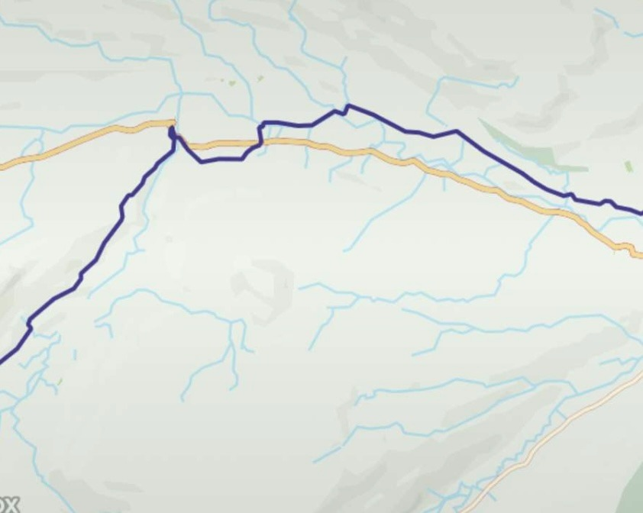
Planning
In order to plan the route of our expedition, we imputed the destinations of the checkpoints using OS mapping, which plotted the most direct route whilst taking into consideration obstacles such as unattainable terrain like, river and mountains, keeping us safe whilst respecting the countryside throughout our expedition.

Slide 4
Our Aim
Our aim was to study the mood of each team member throughout the expedition.
At each checkpoint we recorded each individual member’s mood on a scale of 1-10, with one being the lowest mood rating.
We thought that this aim would be interesting to study as it would show the challenging task presented to us, alongside each individual member of the group's mentality, durability and the way each person was able to display their coping mechanisms at varying times throughout the expedition.

Slide 5
A table of each individual’s values
 | Annabel | Poppy | Beth | Harry | Holly | Average
Day 1: start | 1 | 7 | 8 | 5 | 7 | 5.6
Day 1: CP1 | 2 | 3 | 3 | 1 | 5 | 2.8
Day 1: CP2 | 2 | 1 | 5 | 3 | 2 | 2.6
Day 1: campsite | 10 | 10 | 10 | 9 | 8 | 9.4
Day 2: CP1 | 1 | 2 | 6 | 4 | 6 | 3.8
Day 2: CP2 | 4 | 9 | 9 | 4 | 6 | 6.4
Day 2: campsite | 2.5 | 1 | 7 | 8 | 7 | 5.1
Day 3: CP1 | 6 | 1 | 7 | 6 | 7 | 5.4
Day 3: CP2 | 5 | 0 | 7.5 | 4 | 7 | 4.7
Day 3: finish | 2 | 0 | 3 | 0 | 6 | 2.2
Average | 3.55 | 3.4 | 6.55 | 4.4 | 6.1

Slide 6
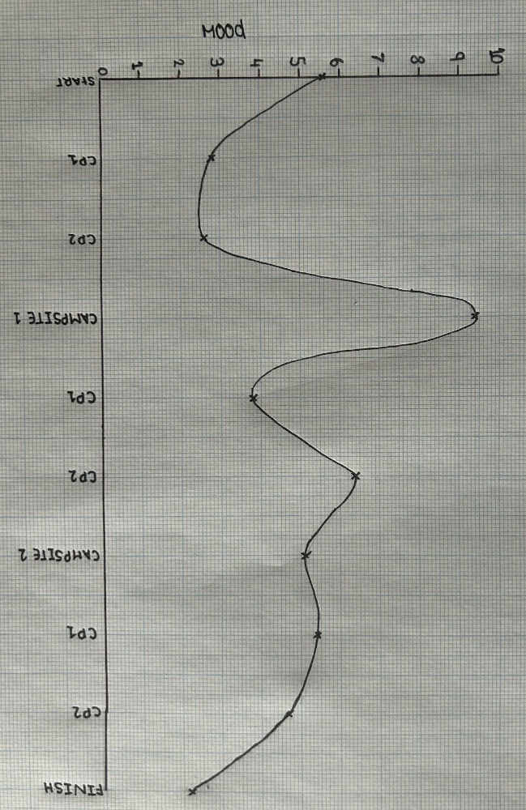
These values are the averages from each checkpoint

Slide 7
Key Takeaways
Over the three days we learnt a lot; the importance to be resilient in order to keep the morale of your group high, the perseverance needed to complete the challenge and the mental and physical strength required.
Although, as a group, we decided that the most significant thing we learnt was the importance of teamwork and how the roles each individual took on, lead to the group’s overall success.

