Slide 1

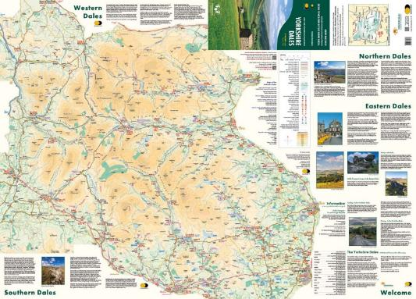

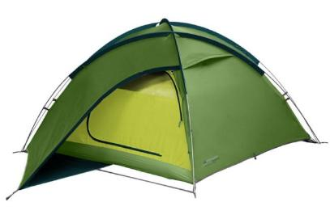



Our gear
Nova 300 3person tent
Nepal 65 rucksack
Maps of the Yorkshire dales
Halo 300 3person tent
Banshee 300 1person tent
Trangia and gas canister
compass
Notes:
Lily

Slide 2
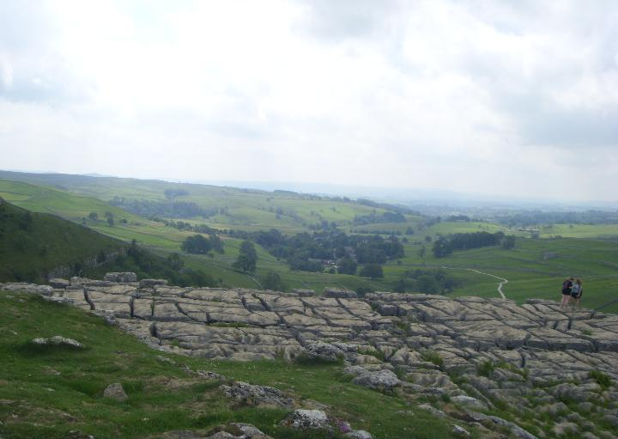
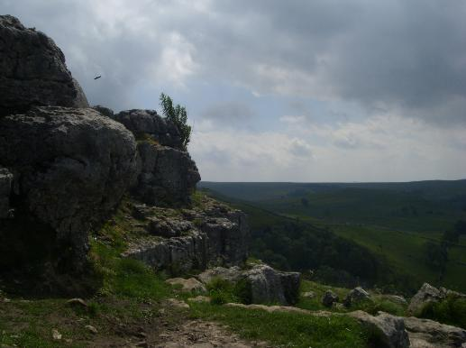
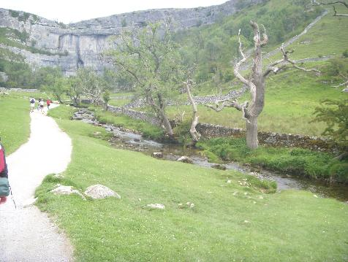
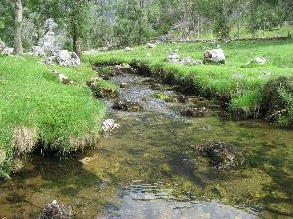
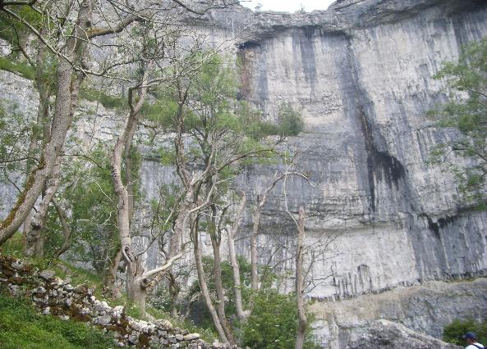
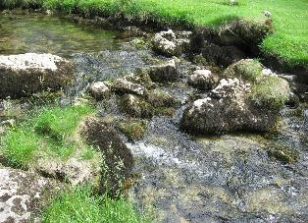
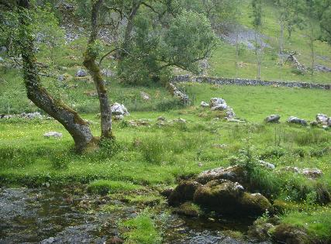
Malham Cove
A limestone cliff formed by formed by a massive waterfall carrying glacial meltwater after the last ice age.
The limestone pavement is formed by karst weathering as the blocks of limestone are separated by deep fissures formed as a result of the dissolving action of rainwater.
The river is called the River Aire.

