Slide 1
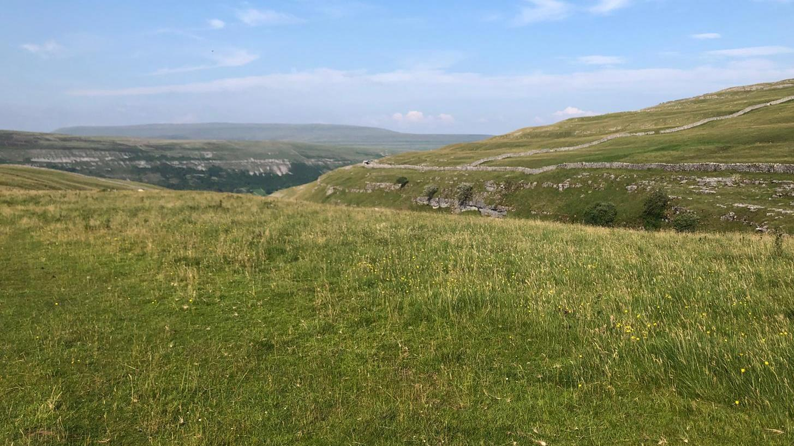
Our silver DofE
Presentation by TEAM ELM

Slide 2
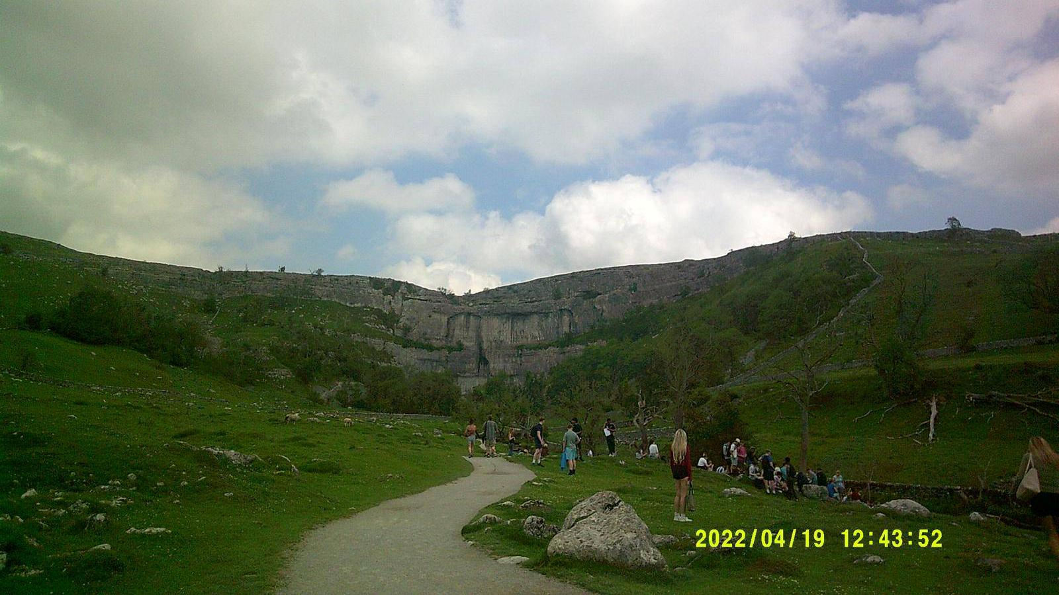
For our dofe, our aim was to photograph beautiful landscapes
We chose this aim as we thought it would be interesting to see the difference in landscapes on our route

Slide 3
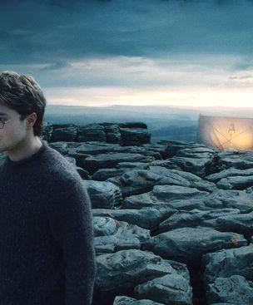
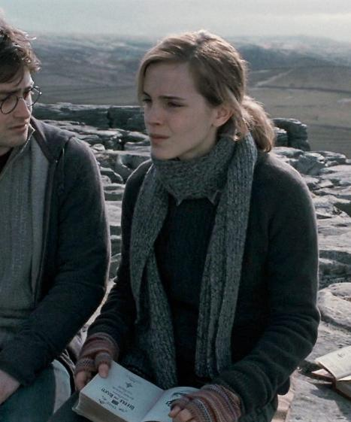
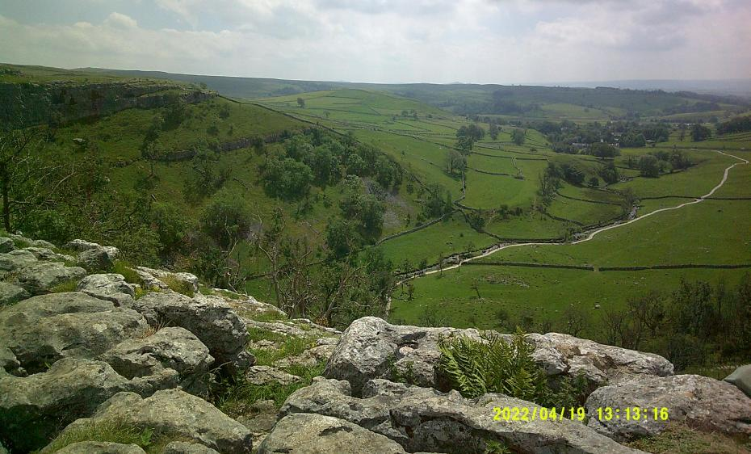
On the first day we climbed Malham Cove,a large cliffside
Did you know Harry Potter was filmed here?
Over the last one and a half million years it was covered by glaciers which, when they melted, eroded the cliffside to make it as steep as it is today.

Slide 4
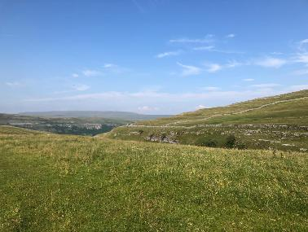
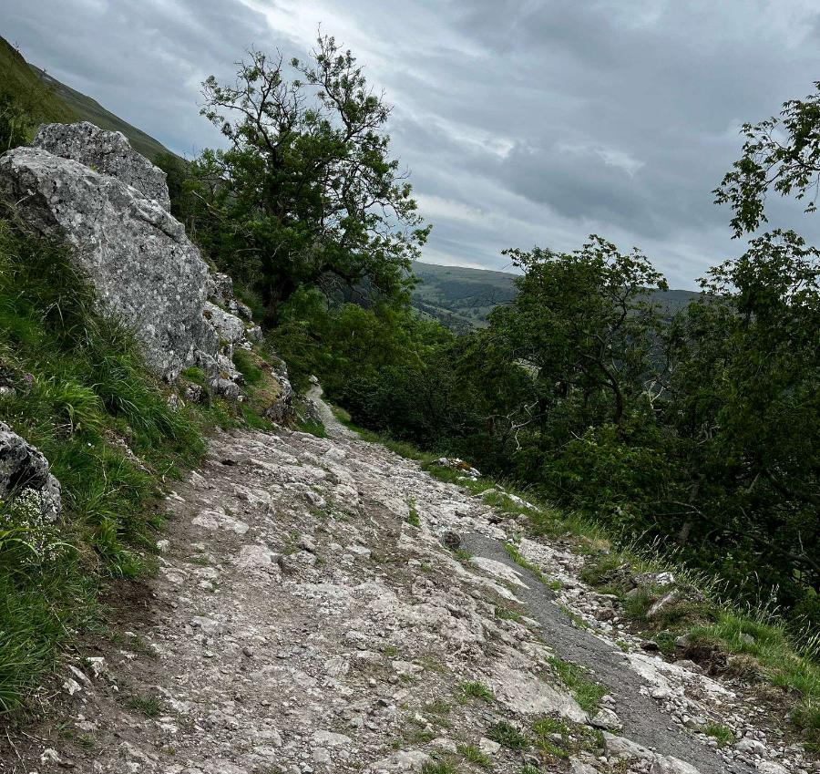
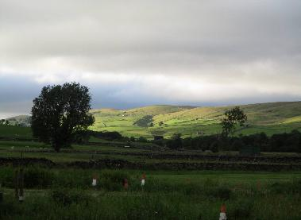
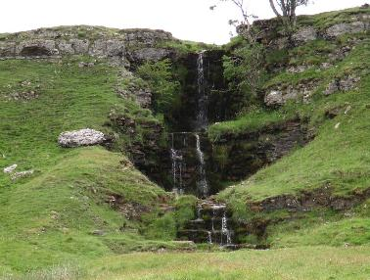
Here’re some of the landscapes we saw
We saw multiple v- shaped valleys and waterfalls that had formed from previous rivers

Slide 5
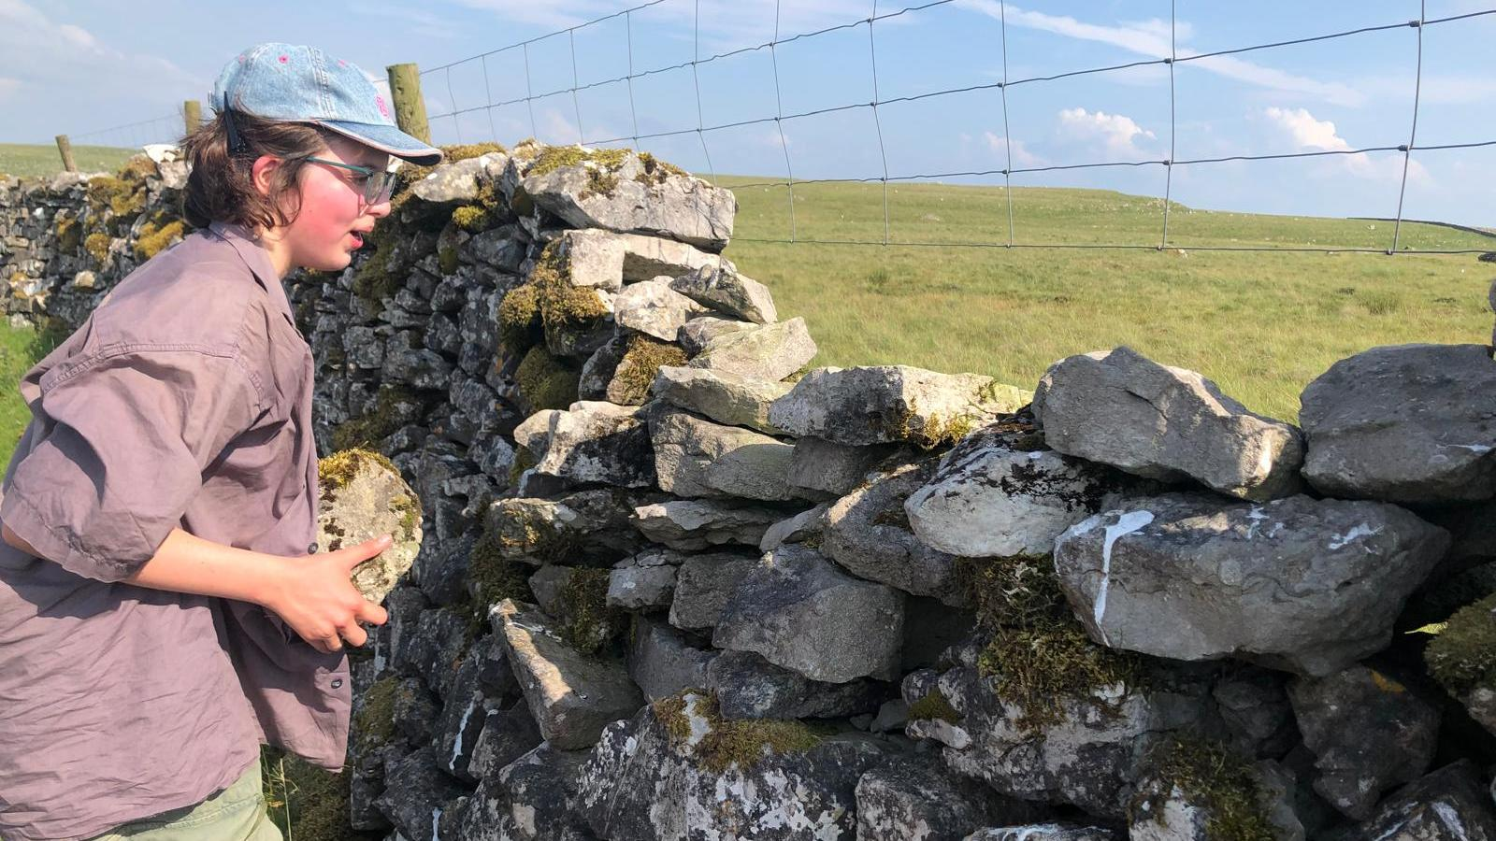
On the first day we climbed a wall in order to get around a gate surrounded by cows with babies
These walls were built to mark field boundaries, define land ownership and manage livestock and only use gravity and interlocking stones for support, no mortar

Slide 6
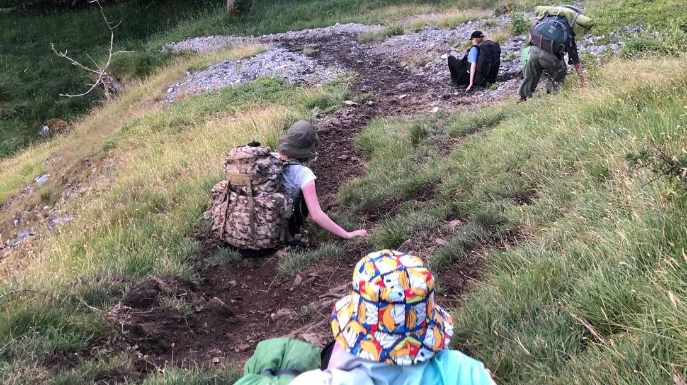
We also slid down a small hill to avoid going back up the mountain side we ended up with us covered in dirt
Most of the mountain was steep and rocky from erosion over time

Slide 7
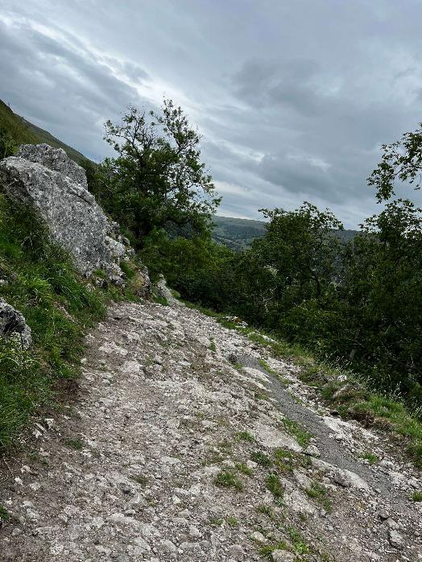
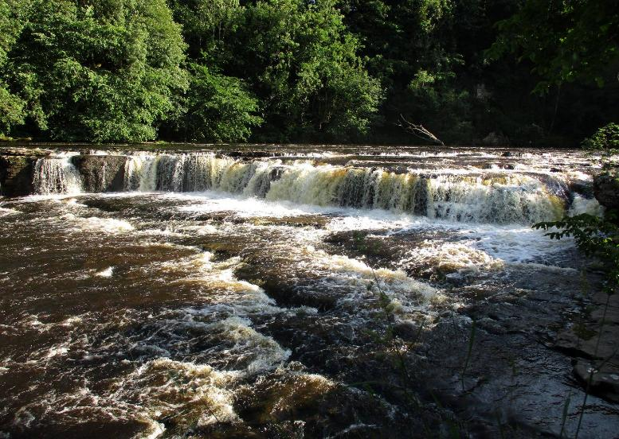
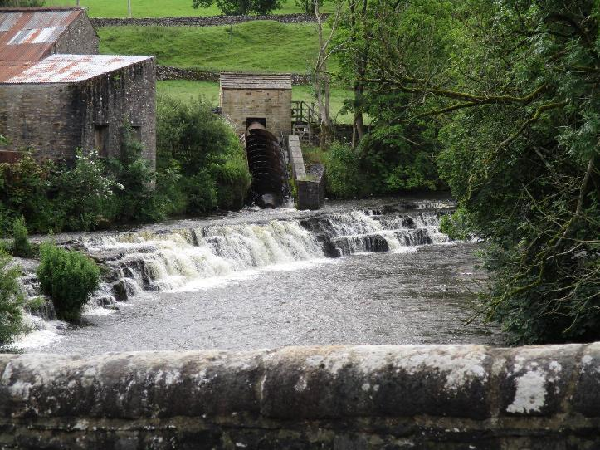
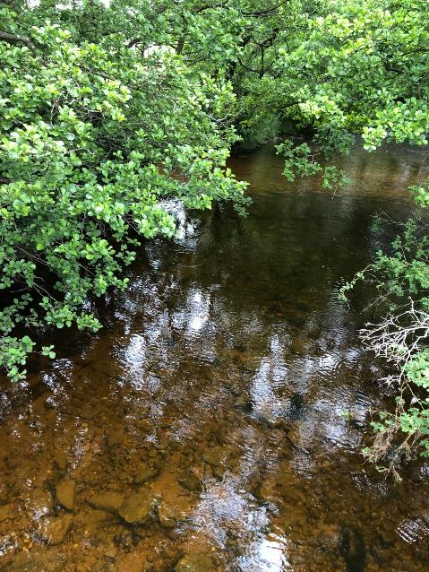
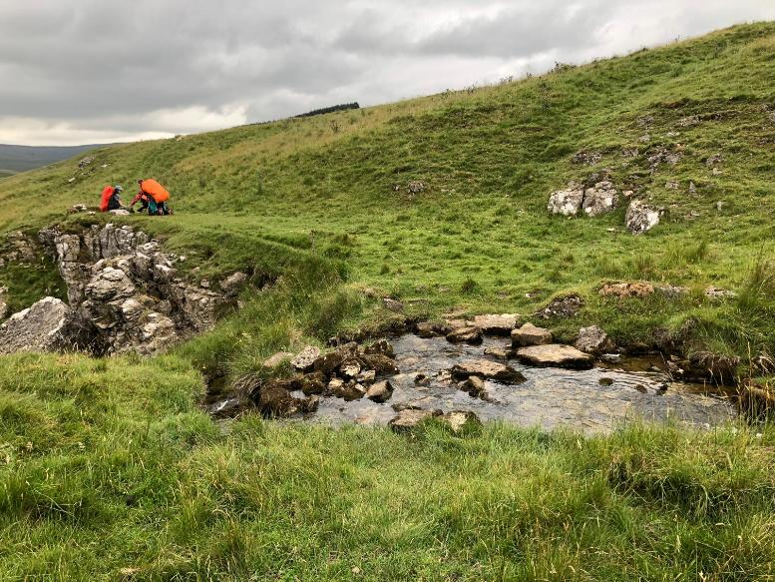
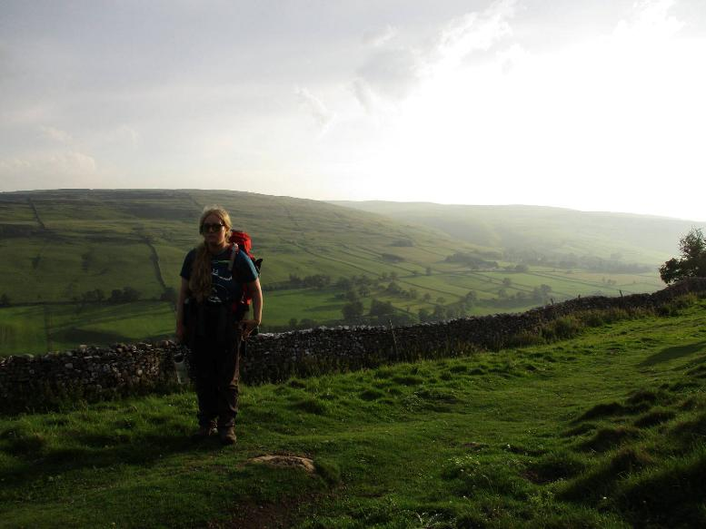

Slide 8
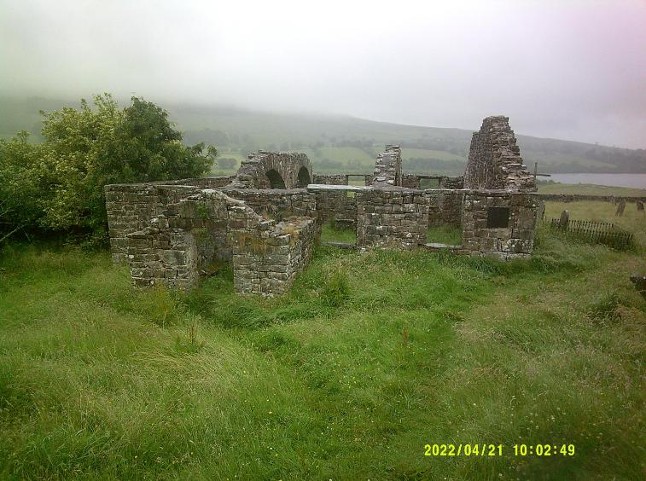
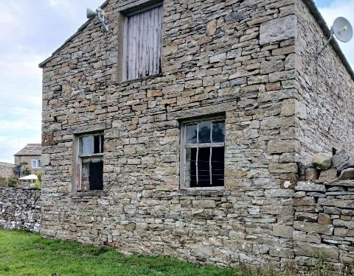
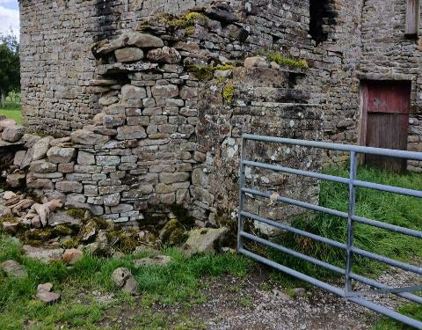
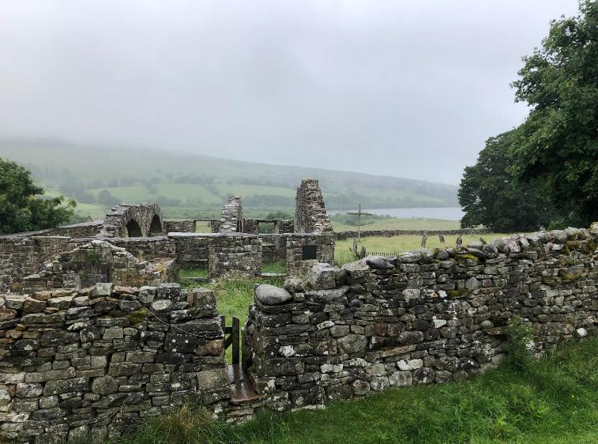
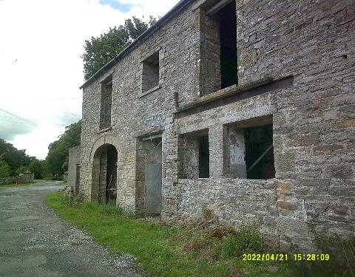
We also saw loads of abandoned buildings

Slide 9
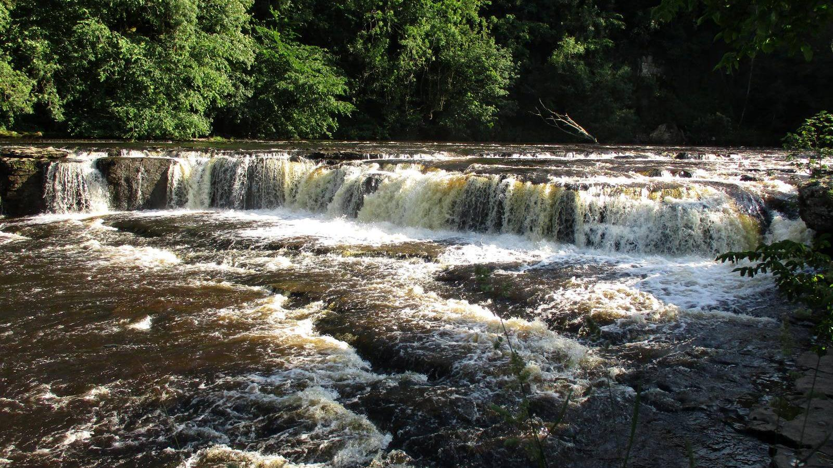
We finished at Aysgarth Falls, which is a triple flight of waterfalls surrounded by woods. The falls look best after heavy rainfall, as thousands of gallons of water cascade over the series of broad limestone steps, which are divided into three stages : upper force, middle force and lower force

