Slide 1

The charity for everyone working in education
Services to support
you and your staff
Notes:
The Employee Assistance Programme, a free service which is paid for by your school to support you with work and personal issues.

Slide 2

Services to support you and your staff
Who are
Education Support?
Part charity and part social enterprise
We support people working in education to be at their best
We have been working in education for over 130 years
We currently support over 90,000 people working in education
We provide services for individuals and for schools and organisations such as charities
Notes:
The service is provided by Education Support Partnership, which is an independent organisation – and NOTHING to do with the management of the school, Ofsted, the local authority etc. I say this to reassure you about the CONFIDENTIALITY of the service. It is a staff benefit that recognises all of us have complex lives these days with lots of demands which will hopefully save you time and money. My purpose is take to you through the services and types of issues which you can use the service for.

Slide 3
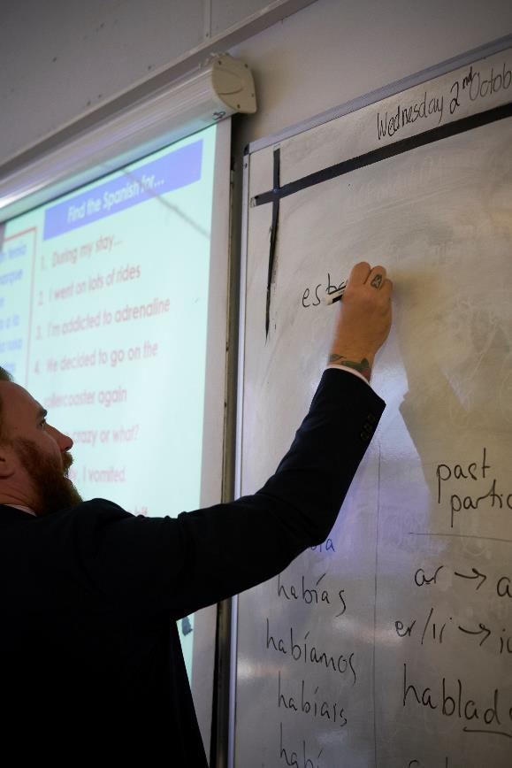
Services to support you and your staff
Free Services
Confidential and free telephone in the moment support
Financial Support (grants)
Short term financial emergencies
Essential, but unaffordable items or costs, which contribute to improving health and wellbeing
Help to stay in or get back to work
https://www.educationsupport.org.uk/
helping-you/apply-grant

Slide 4

Services to support you and your staff
Free Support
Information and Guidance on
www.educationsupport.org.uk
Our website has information and advice via our blog and Life Guides. Some topics include:
Grappling with work-life balance
Handling Stress
Managing disagreements at school
Managing your time
Relationships at work
Managing difficult student behaviour

Slide 5

Services to support you and your staff
Employee Assistance Programme
Impartial support and options to address work-related challenges.
Access to practical resources enabling staff to address personal problems
Fast track support by telephone and for face to face counselling
Emotional support to line managers in resolving staff issues.
Supports an Employer’s Duty of Care responsibility
Notes:
In summary the service provides you with 24-hour telephone counselling, 365 days a week by qualified counsellors, access to up to 6 face to face counselling sessions per issue near a counsellor where you live and access to a broad range of information, guidance and support on life issues from 8am to 8pm on weekdays and 9am-5pm on a Saturday. I am going to talk through some of the types of issues you can use it for.

Slide 6

Services to support you and your staff
Managing our working lives
Feeling overwhelmed
On the spot supervision
Relationships with colleagues
Issues for NQTs
Work-life balance
Communication skills
Time management
Conflict/difficult behaviour
Workload
Change
Bullying
Notes:
The service can be used for work and personal issues. The model of counselling is solution-focused counselling which enables you to work through the particular presenting issue (without going into your childhood) and feelings so that you get the support to explore your possible options to move forward. You can see the types of issues you can use the service for on the slide, so if you find yourself waking up at 3am in the morning feeling anxious and overwhelmed you could get support from a counsellor.
Another scenario would be if you have just come out of a difficult child protection meeting – you could get immediate emotional support so you are not carrying it around with you. It is not ongoing clinical supervision.

Slide 7

Services to support you and your staff
Managing our personal lives
Family relationships
Couples counselling
Teenage children
Bereavement
Infertility
Serious illness
Divorce
Substance/alcohol abuse
Miscarriage
Caring for elderly relatives
Depression
Anxiety
Domestic abuse
Notes:
In addition to the 24 hour telephone counselling service you can receive up to 6 sessions of Structured Telephone Counselling OR face to face counselling with a counsellor near your home. (Our aim is that the furthest distance an individual would have to travel is 25 miles from their home or school).
You could use the service for 6 sessions of bereavement counselling and then later in the year for 6 sessions of couples counselling – providing you say that the issue is impacting on your ability to do your job. This is the only time family members can be involved.

Slide 8
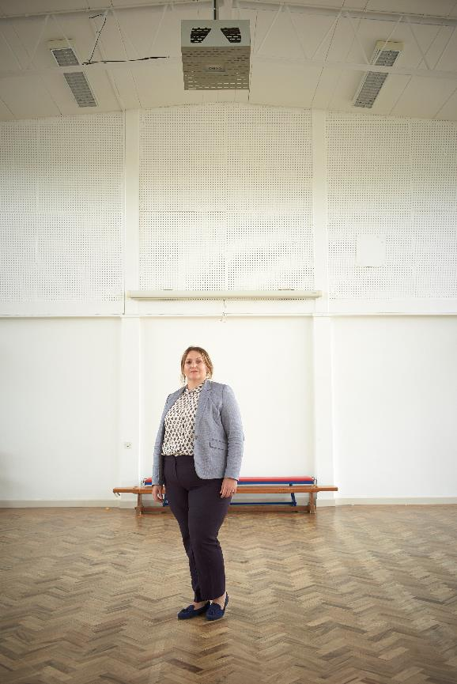
Services to support you and your staff
Manager Assist
Managing performance
Motivation and morale
Supporting colleagues on constructively
Difficult conversations
Managing absence and return to work
Organisational change
Sensitive issues
Redundancy/early retirement
Notes:
We provide Manager Assist as a type of coaching service that enables line managers to talk through or rehearse how to approach difficult or sensitive issues. It is NOT HR. Examples can include:
When a line manager has talk to a member of staff about their body odour problem;
Concerns about a member of staff experiencing domestic violence;
Team conflict.

Slide 9
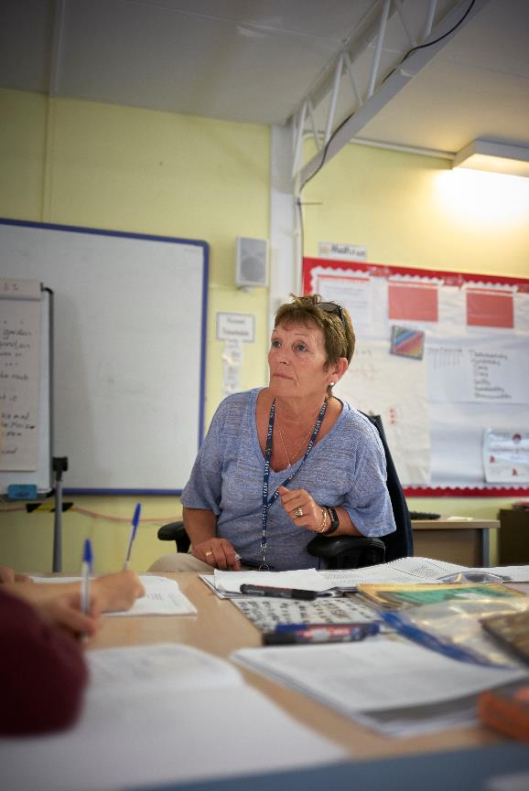
Services to support you and your staff
General Information
Holiday problems
Noisy neighbours
Tax
Housing/landlord issues
Maternity leave
Faulty goods and consumer rights
Child support
Care homes and eldercare
State benefits
Pet sitters
Human rights queries
Notes:
There are 3 services that are available from 8am to 8pm during the week and 9am to 5pm on a Saturday. Information Services which service covers CAB type issues, and the others are the financial and legal service. The types of issues the Information Service can cover are if you have noisy neighbours, or if you have an elderly parent who has the early signs of dementia – and you want to look a the different types of care and if you could have access to some type of State Entitlement. I have been told they could find out about local child minders or Pet Sitters in your area.

Slide 10
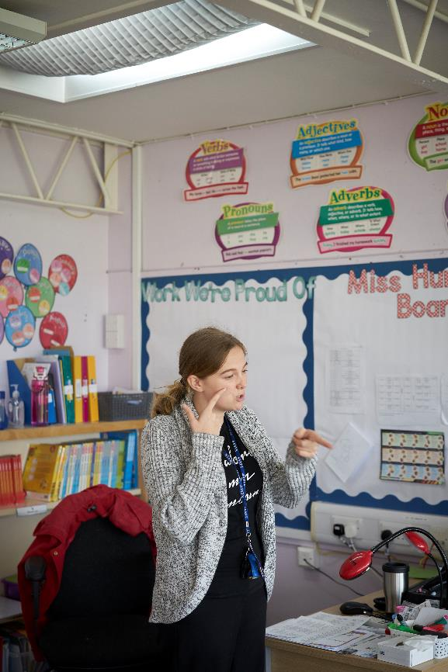
Services to support you and your staff
Financial issues
General debt counselling
Mortgage guidance
Loans and overdrafts
Wills and inheritance tax planning
Personal taxation issues
Divorce/partnership breakdowns
Pensions
General financial planning
Redundancy/early retirement
Investment guidance
Notes:
The financial service is staffed by debt counsellors and financial advisers (who are not selling products). You can receive structured debt counselling and financial guidance, support and signposting NOT ADVICE, because they cannot take on individual cases. It can be used as a first port of call when you are thinking of moving or you want to start to understand the new pension regulations in a general way.

Slide 11
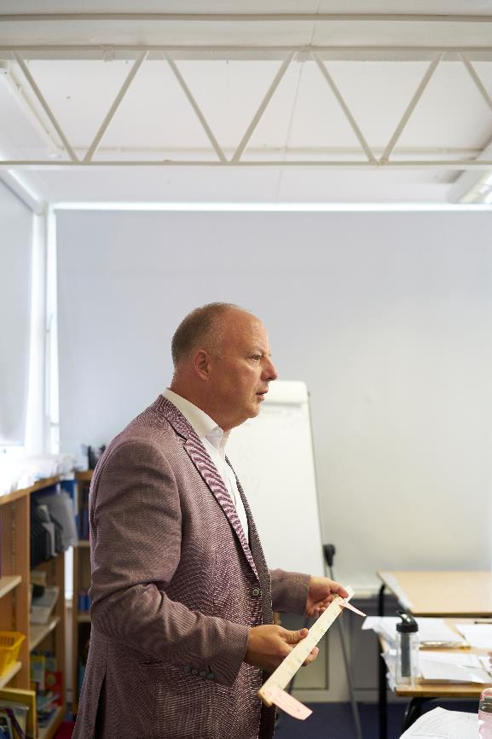
Services to support you and your staff
Legal enquiries
Matrimonial
Consumer issues
Insurance
Power of attorney
Motoring offence
Disputes with local authority
Council tax
Welfare law
Probate
Wills
Property issues
Notes:
The Legal Service is staffed by Legal Executives, who cannot give ADVICE. However they can signpost, give information and support.
An example is where a member of staff had an older brother in a residential care home near where she lived. She would visit him once a week to check he was okay. She was a single parent with small children, who also helped her elderly parents.
The Council decided to move her brother out of the area (about 2 counties away because it would be cheaper for them). This caused major concerns for her in terms of expenses and her ability to visit him. She was able to ring the Legal Service who took her though how to put in an appeal. She said that the service saved her time and money.

Slide 12
Services to support you and your staff
Face to Face Counselling 08000 856 148
Over 1,100 UK Based Counsellors
Local to Home or Work
Short Term, Solution Focused Therapy used – same kind whether delivered by telephone or face to face
Up to 6 sessions of Structured Telephone or Face to Face Counselling per issue – suitability for short term counselling is determined by clinical assessment
Support available 24 hours a day 365 days a year, confidential & free to end user
Where a long-term or open-ended support need is identified we can help with information about where to try and locate this
Notes:
To summarise we have over 1000 qualified counsellors. Service Level Agreement are that appointments made within 5 days of the individual phoning and you will be seen within 10 days’ of having made the phone call – compare it to a 3-4 month wait with the NHS. Our aim is to provide you with relatively easy access to support.

Slide 13
Services to support you and your staff
Qualifications and experience
08000 856 148
BACP Accredited and clinically supervised
Minimum of 450 hours supervised counselling hours experience
Clinical or psychology based degree
Information specialists have relevant qualification (Minimum Law degree and Legal Practice Certificate)
Debt advisers are Financial Conduct Authority licensed money advisers
Notes:
All the counsellors are professionally qualified and members of the British Association of Counselling and Psychotherapy, which means they work to their Code of Ethics. In terms of confidentiality it means that everything that gets discussed between you and service is completely confidential – UNLESS you were going to harm yourself or another person.
All counsellors are qualified to degree level and have a minimum of 450 hours counselling experience and are clinically supervised.
All the members of the legal team have the minimum of a law degree and a Legal Practice Certificate.
The Financial service is staffed by qualified Financial Advisers or debt counsellors who are members of the Financial Conduct Authority.

Slide 14
Services to support you and your staff
What happens when you call?
08000 856 148
You’ll hear an automated welcome message regarding GDPR
You can use your keypad to indicate consent
All calls then go through to the team
Callers are asked to give their school name (so we can check your school or organisation is signed up)
Callers are asked for name and contact details (this is confidentially stored)
Callers are allocated to the appropriate service(s) or call backs are arranged
All call backs will come from withheld numbers
Notes:
When you ring the service all you have to say is your school’s name and you only have to give your first name or even a pseudonym. You will be then directed to the relevant service.

Slide 15
Services to support you and your staff
Privacy and confidentiality
08000 856 148
All calls are completely confidential
Personal information about callers or about specific calls is never divulged
Notes:
I want to reassure you again that everything that happens in completely confidential (unless you were to harm yourself or someone else).

Slide 16
Services to support you and your staff
Take a minute to save
08000 856 148
In your phone now
Notes:
I want to reassure you again that everything that happens in completely confidential (unless you were to harm yourself or someone else).

Slide 17

Services to support you and your staff
Promotional Materials
Launch
Cards
Leaflets
Posters
The service from Education Support is highly valued by our staff. It has sent a signal to them that shows we care.
Melanie Adams, HR Director, The Collegiate Academy Trust
Notes:
Each school receives a pack of cards, bookmarks and leaflets for each member of staff and posters to remind you of the service.

Slide 18
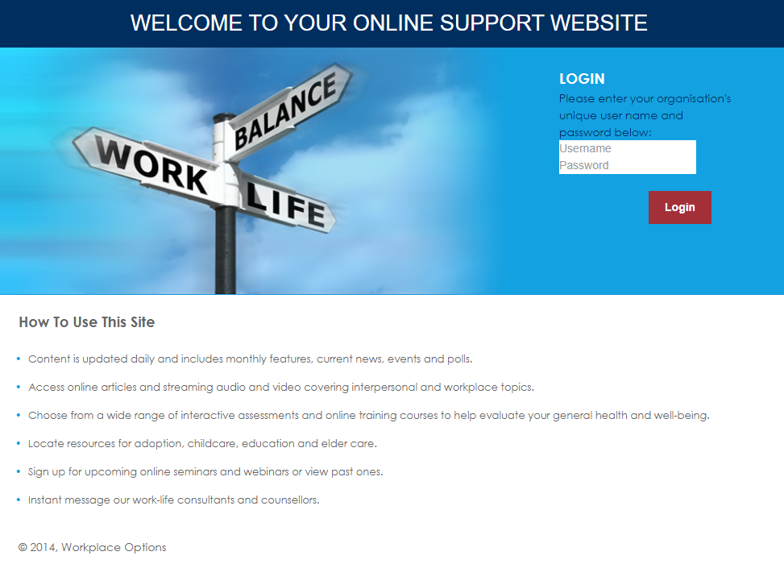
Services to support you and your staff
Advice Centre Plus
www.educationsupport.org.uk/onlinesupport
Username: worklifesupport
Password: support1
Notes:
You can also access online materials, fact sheets etc which are downloadable, form the above website. The details are also on your promotional materials.

Slide 19

Services to support you and your staff
Real Messaging/Live Connect
The advice centre is where you are able to access the instant messaging service (Real Messaging / Live Connect)
You can access this by clicking on the icon in the top right hand corner.

Slide 20
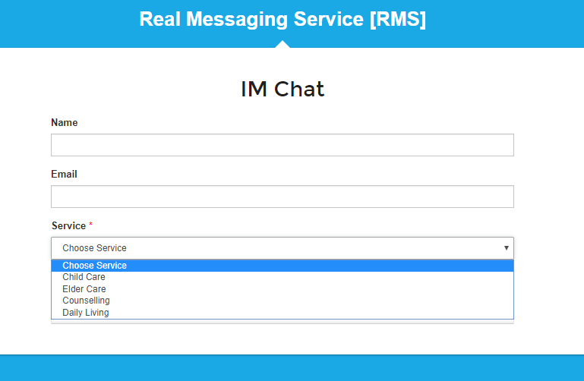
Services to support you and your staff
Real Messaging/Live Connect
Notes:
When you click on the icon you will be taken to another screen and asked to fill in the details to join a chat session.
You’ll be asked to select a service in order that the most appropriate team answers your request and headings include, Daily Living Child Care, Elder Care or Counselling.
Daily living might relate to financial, legal or anything that doesn’t naturally sit under Child Care, Elder Care or Counselling.

Slide 21
Services to support you and your staff
Service Issues
Contact Details
Raise directly with the EAP team on your usual EAP number
Or contact Ed Support’s head office team on:
0207 697 2750/ servicedelivery@edsupport.org.uk
Notes:
You can also access online materials, fact sheets etc which are downloadable, form the above website. The details are also on your promotional materials.

